Slide 1
Application Layer Functionality and Protocols
Network Fundamentals – Chapter 3

Slide 2
Objectives
Define the application layer as the source and destination of data for communication across networks.
Explain the role of protocols in supporting communication between server and client processes.
Describe the features, operation, and use of well-known TCP/IP application layer services (HTTP, DNS, SMTP).

Slide 3
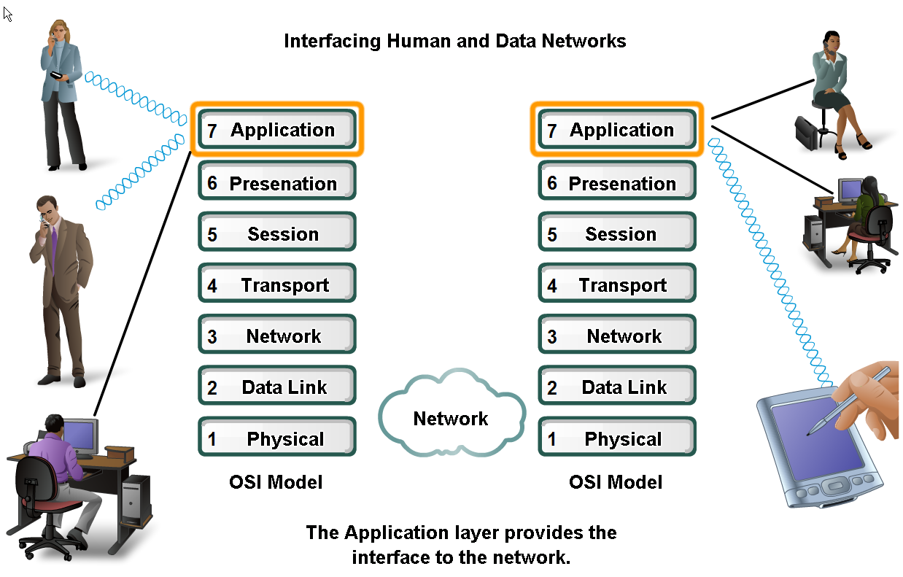
Applications – The Interface Between Human and Data Networks
Explain that applications provide the means for generating and receiving data that can be transported on the network

Slide 4
Typical Data Network
In this model, information is passed from one layer to the next, starting at the Application layer on the transmitting host, proceeding down the hierarchy to the Physical layer, then passing over the communications channel to the destination host, where the information proceeds back up the hierarchy, ending at the Application layer.
The Application layer, Layer seven, is the top layer of both the OSI and TCP/IP models. It is the layer that provides the interface between the applications we use to communicate and the underlying network over which our messages are transmitted.
Application layer protocols are used to exchange data between programs running on the source and destination hosts.
There are many Application layer protocols and new protocols are always being developed.

Slide 5
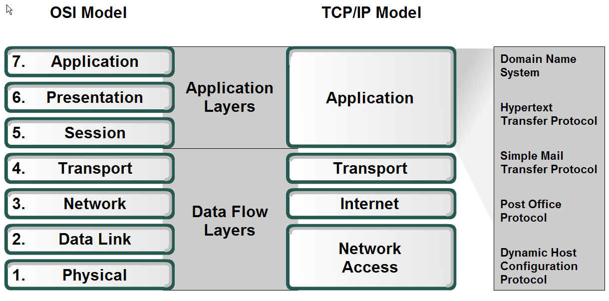
Applications – The Interface Between Human and Data Networks
Define the separate roles applications, services and protocols play in transporting data through networks

Slide 6
Presentation Layer
The Presentation layer has three primary functions:
Coding and conversion of Application layer data to ensure that data from the source device can be interpreted by the appropriate application on the destination device.
Compression of the data in a manner that can be decompressed by the destination device.
Encryption of the data for transmission and the decryption of data upon receipt by the destination

Slide 7
Other Presentation Layer Protocols
Presentation layer implementations are not typically associated with a particular protocol stack.
The standards for video and graphics are examples. Some well-known standards for video include QuickTime and Motion Picture Experts Group (MPEG). QuickTime is an Apple Computer specification for video and audio, and MPEG is a standard for video compression and coding.
Among the well-known graphic image formats are Graphics Interchange Format (GIF), Joint Photographic Experts Group (JPEG), and Tagged Image File Format (TIFF).
GIF and JPEG are compression and coding standards for graphic images, and TIFF is a standard coding format for graphic images.

Slide 8
The Session Layer
As the name of the Session layer implies, functions at this layer create and maintain dialogs between source and destination applications.
The Session layer handles the exchange of information to initiate dialogs, keep them active, and to restart sessions that are disrupted or idle for a long period of time.
Most applications, like web browsers or e-mail clients, incorporate functionality of the OSI layers 5, 6 and 7.

Slide 9
TCP/IP Protocols
The most widely-known TCP/IP Application layer protocols are those that provide for the exchange of user information.
These protocols specify the format and control information necessary for many of the common Internet communication functions. Among these TCP/IP protocols are:
Domain Name Service Protocol (DNS) is used to resolve Internet names to IP addresses.
Hypertext Transfer Protocol (HTTP) is used to transfer files that make up the Web pages of the World Wide Web.
Simple Mail Transfer Protocol (SMTP) is used for the transfer of mail messages and attachments.
Telnet, a terminal emulation protocol, is used to provide remote access to servers and networking devices.
File Transfer Protocol (FTP) is used for interactive file transfer between systems.

Slide 10
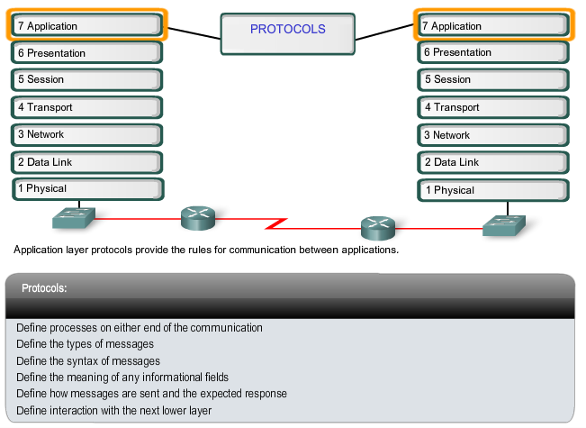
Application Layer Protocols

Slide 11
How Protocols are Used
Application layer protocols are used by both the source and destination devices during a communication session. In order for the communications to be successful, the Application layer protocols implemented on the source and destination host must match.
Protocols establish consistent rules for exchanging data between applications and services loaded on the participating devices.
Protocols specify how data inside the messages is structured and the types of messages that are sent between source and destination.
These messages can be requests for services, acknowledgments, data messages, status messages, or error messages. Protocols also define message dialogues, ensuring that a message being sent is met by the expected response and the correct services are invoked when data transfer occurs.
Applications and services may also use multiple protocols in the course of a single conversation. One protocol may specify how to establish the network connection and another describe the process for the data transfer when the message is passed to the next lower layer.

Slide 12
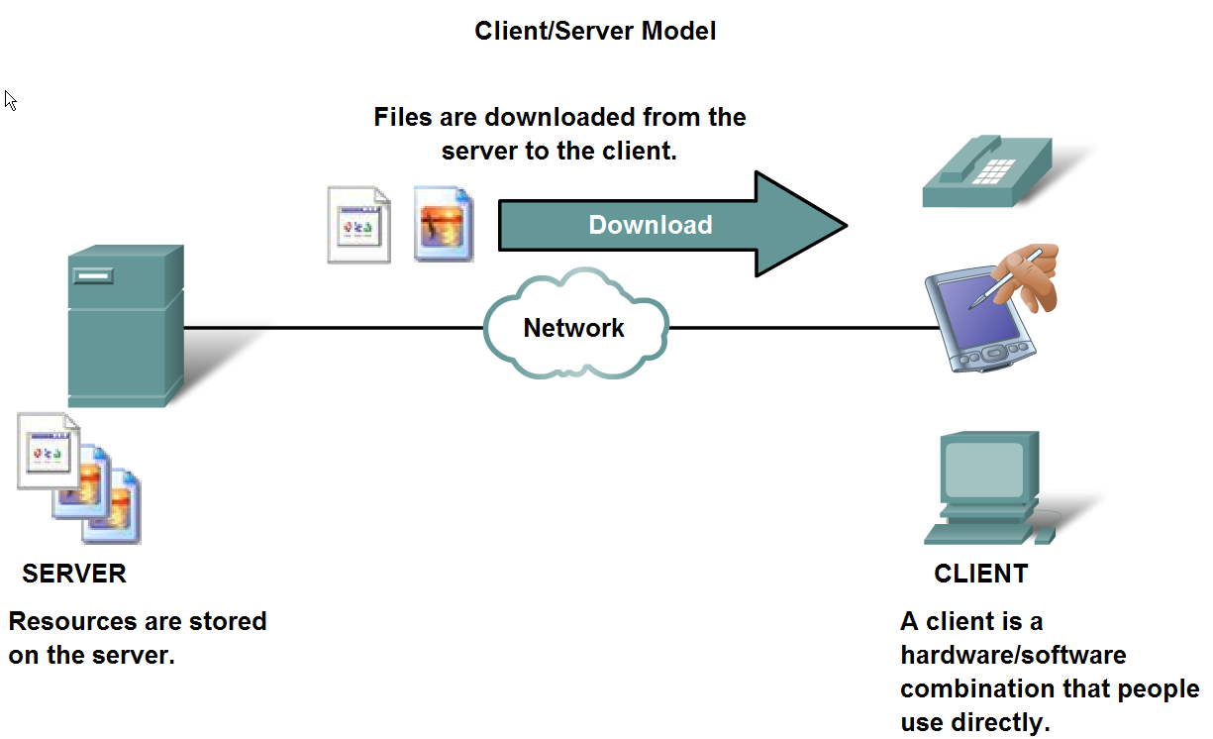
The Role of Protocols in Supporting Communication
Describe the roles of client and server processes in data networks

Slide 13
Client/Server Model
In the client/server model, the device requesting the information is called a client and the device responding to the request is called a server.
Client and server processes are considered to be in the Application layer.
The client begins the exchange by requesting data from the server, which responds by sending one or more streams of data to the client.
Application layer protocols describe the format of the requests and responses between clients and servers. In addition to the actual data transfer, this exchange may also require control information, such as user authentication and the identification of a data file to be transferred.

Slide 14
Servers
In a general networking context, any device that responds to requests from client applications is functioning as a server. A server is usually a computer that contains information to be shared with many client systems
Different types of server applications may have different requirements for client access.
Some servers may require authentication of user account information to verify if the user has permission to access the requested data or to use a particular operation.
Such servers rely on a central list of user accounts and the authorizations, or permissions, (both for data access and operations) granted to each user.

Slide 15
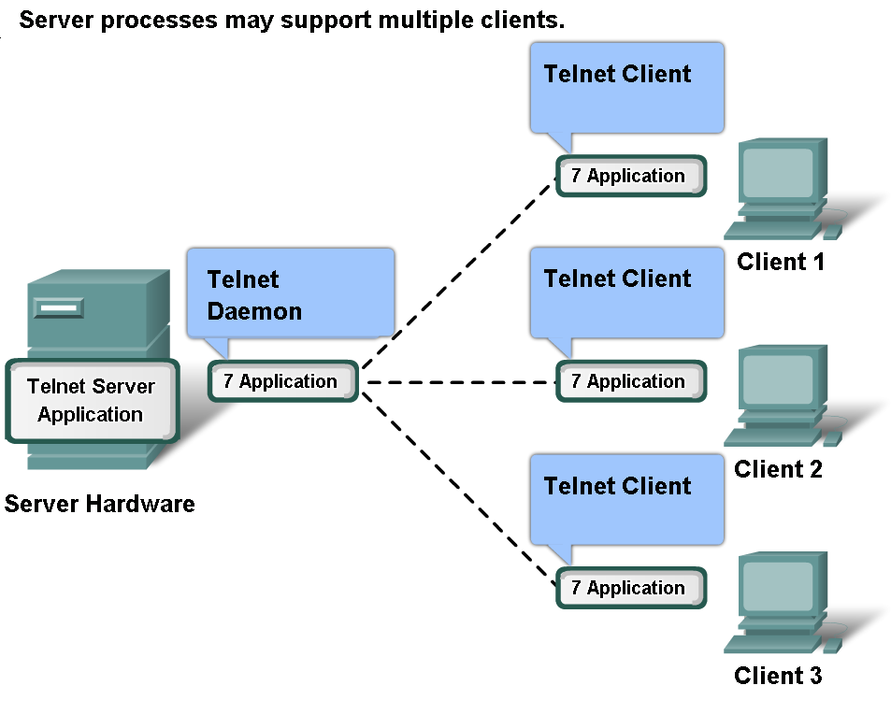
The Role of Protocols in Supporting Communication
List common Application Layers services and protocols
Additionally, servers typically have multiple clients requesting information at the same time.
For example, a Telnet server may have many clients requesting connections to it.
These individual client requests must be handled simultaneously and separately for the network to succeed.
The Application layer processes and services rely on support from lower layer functions to successfully manage the multiple conversations.

Slide 16
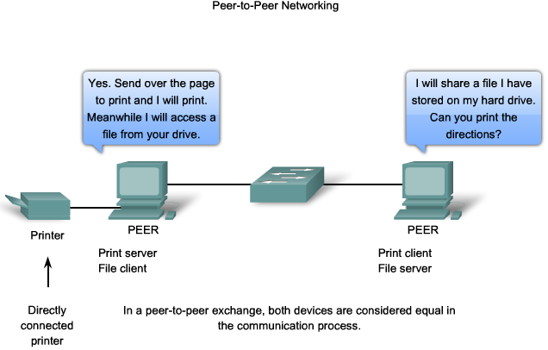
Peer-to-Peer Networking

Slide 17
P2P Network
In a peer-to-peer network, two or more computers are connected via a network and can share resources (such as printers and files) without having a dedicated server.
Every connected end device (known as a peer) can function as either a server or a client. One computer might assume the role of server for one transaction while simultaneously serving as a client for another.
The roles of client and server are set on a per request basis.
A simple home network with two connected computers sharing a printer is an example of a peer-to-peer network.
Because peer-to-peer networks usually do not use centralized user accounts, permissions, or monitors, it is difficult to enforce security and access policies in networks containing more than just a few computers. User accounts and access rights must be set individually on each peer device.

Slide 18
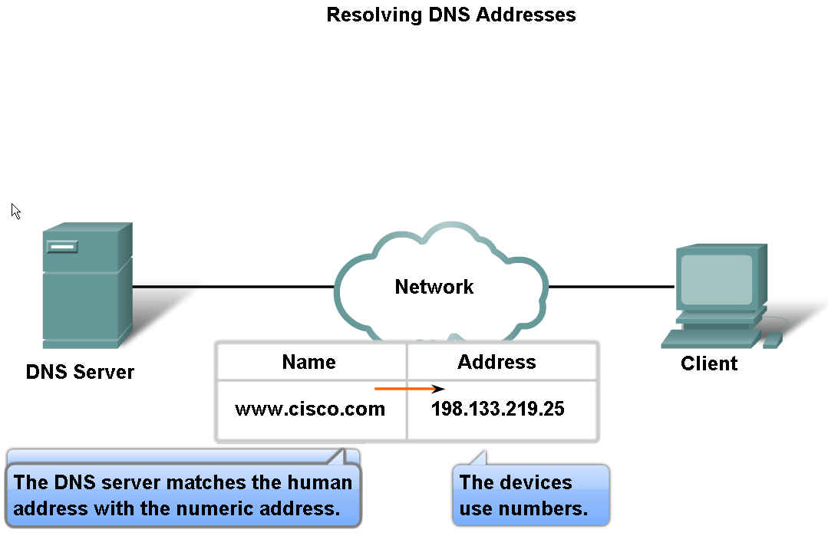
Features, Operation, and Use of TCP/IP Application Layer Services
Describe the features of the DNS protocol and how this protocol supports DNS services

Slide 19
DNS
In data networks, devices are labelled with numeric IP addresses, so that they can participate in sending and receiving messages over the network.
On the Internet these domain names, such as www.cisco.com, are much easier for people to remember than 198.133.219.25, which is the actual numeric address for this server.
Also, if Cisco decides to change the numeric address, it is transparent to the user, since the domain name will remain www.cisco.com.
The new address will simply be linked to the existing domain name and connectivity is maintained
The Domain Name System (DNS) was created for domain name to address resolution for these networks.

Slide 20
DNS Protocol
The DNS protocol defines an automated service that matches resource names with the required numeric network address.
It includes the format for queries, responses, and data formats.
DNS protocol communications use a single format called a message.
This message format is used for all types of client queries and server responses, error messages, and the transfer of resource record information between servers.

Slide 21
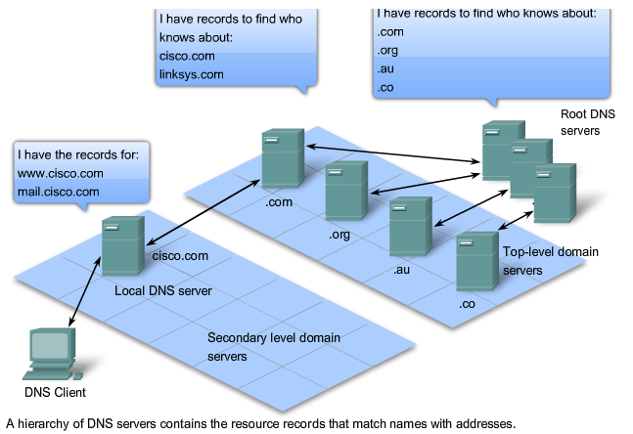
DNS Hierarchy

Slide 22
System Hierarchy
The Domain Name System uses a hierarchical system to create a name database to provide name resolution. The hierarchy looks like an inverted tree with the root at the top and branches below.
At the top of the hierarchy, the root servers maintain records about how to reach the top-level domain servers, which in turn have records that point to the secondary level domain servers and so on.
The different top-level domains represent either the type of organization or the country of origin. Examples of top-level domains are:
.au - Australia
.co - Colombia
.com - a business or industry
.jp - Japan
.org - a non-profit organization

Slide 23
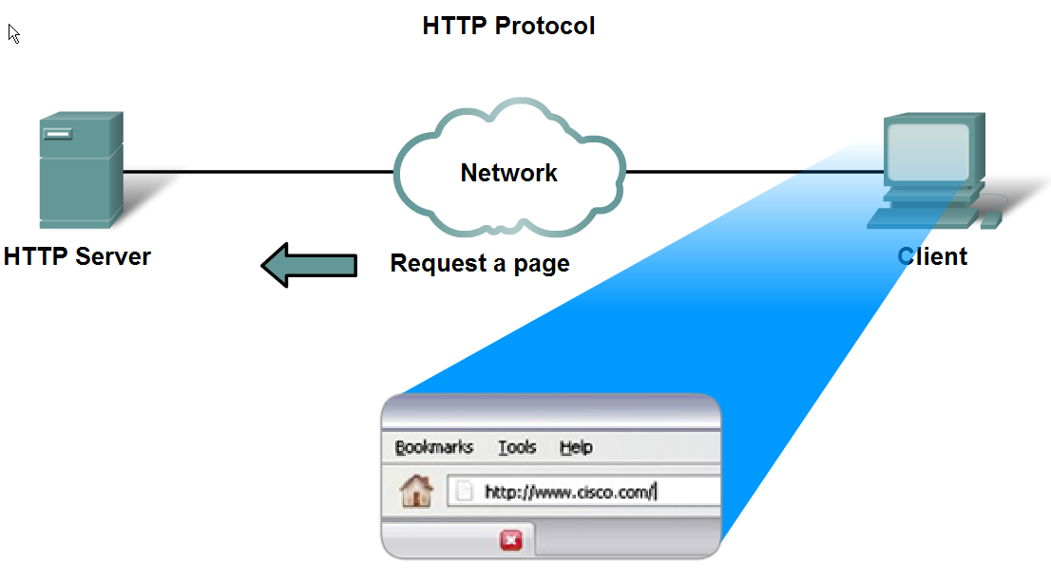
Features, Operation, and Use of TCP/IP Application Layer Services
Describe the features of the HTTP protocol and how this protocol supports the delivery of web pages to the client

Slide 24
Web Browsers
Web browsers are the client applications our computers use to connect to the World Wide Web and access resources stored on a web server.
As with most server processes, the web server runs as a background service and makes different types of files available.
In order to access the content, web clients make connections to the server and request the desired resources.
The server replies with the resources and, upon receipt, the browser interprets the data and presents it to the user.

Slide 25
How it Works
First, the browser interprets the three parts of the URL:
1. http (the protocol or scheme)
2. www.cisco.com (the server name)
3. web-server.htm (the specific file name requested).
The browser then checks with a name server to convert www.cisco.com into a numeric address, which it uses to connect to the server.
Using the HTTP protocol requirements, the browser sends a GET request to the server and asks for the file web-server.htm.
The server in turn sends the HTML code for this web page to the browser. Finally, the browser deciphers the HTML code and formats the page for the browser window.

Slide 26
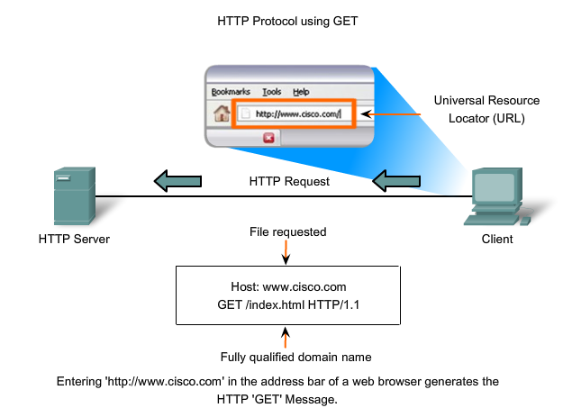
HTTP Verbs

Slide 27
Verbs Explained
GET is a client request for data. A web browser sends the GET message to request pages from a web server.
Once the server receives the GET request, it responds with a status line, such as HTTP/1.1 200 OK, and a message of its own, the body of which may be the requested file, an error message, or some other information.
POST and PUT are used to send messages that upload data to the web server. For example, when the user enters data into a form embedded in a web page, POST includes the data in the message sent to the server.
PUT uploads resources or content to the web server

Slide 28
HTTP and Security
Although it is remarkably flexible, HTTP is not a secure protocol. The POST messages upload information to the server in plain text that can be intercepted and read.
Similarly, the server responses, typically HTML pages, are also unencrypted.
For secure communication across the Internet, the HTTP Secure (HTTPS) protocol is used for accessing or posting web server information.
HTTPS can use authentication and encryption to secure data as it travels between the client and server. HTTPS specifies additional rules for passing data between the Application layer and the Transport Layer.

Slide 29
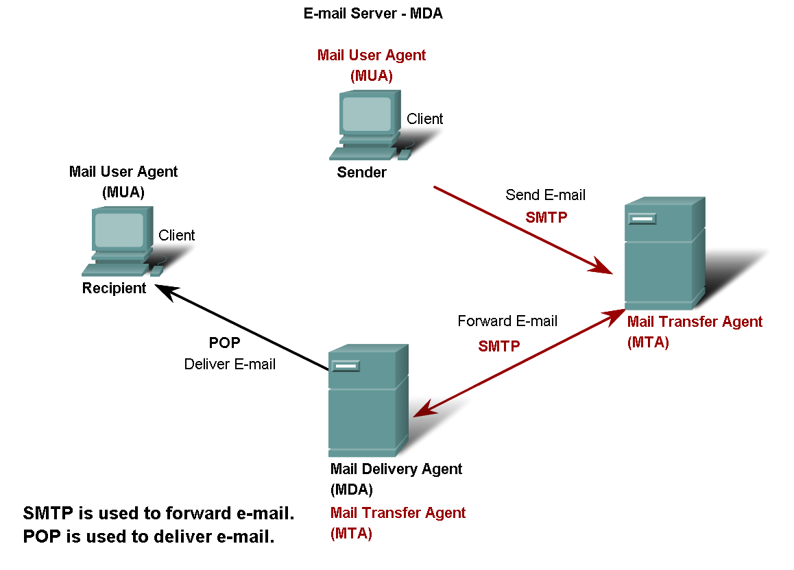
Features, Operation, and Use of TCP/IP Application Layer Services
Describe the features of the POP and SMTP protocols, and how these protocols support e-mail services

Slide 30
Mail Server Processes
The e-mail server operates two separate processes:
Mail Transfer Agent (MTA)
Mail Delivery Agent (MDA)
The Mail Transfer Agent (MTA) process is used to forward e-mail. As shown in the figure, the MTA receives messages from the MUA or from another MTA on another e-mail server.
Based on the message header, it determines how a message has to be forwarded to reach its destination.
If the mail is addressed to a user whose mailbox is on the local server, the mail is passed to the MDA.
If the mail is for a user not on the local server, the MTA routes the e-mail to the MTA on the appropriate server.

Slide 31
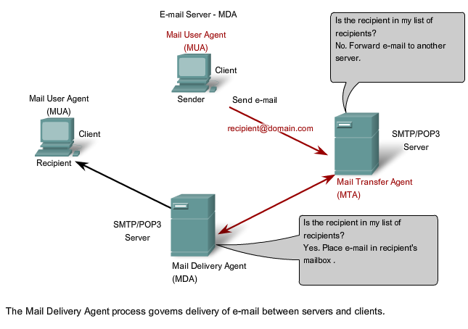
MUA, MTA, MDA

Slide 32
Roles
In the figure, we see that the Mail Delivery Agent (MDA) accepts a piece of e-mail from a Mail Transfer Agent (MTA) and performs the actual delivery.
The MDA receives all the inbound mail from the MTA and places it into the appropriate users' mailboxes.
The MDA can also resolve final delivery issues, such as virus scanning, spam filtering, and return-receipt handling.
Most e-mail communications use the MUA, MTA, and MDA applications. However, there are other alternatives for e-mail delivery.

Slide 33
SMTP
The SMTP protocol message format uses a rigid set of commands and replies.
These commands support the procedures used in SMTP, such as session initiation, mail transaction, forwarding mail, verifying mailbox names, expanding mailing lists, and the opening and closing exchanges.
Some of the commands specified in the SMTP protocol are:
HELO - identifies the SMTP client process to the SMTP server process
EHLO - Is a newer version of HELO, which includes services extensions
MAIL FROM - Identifies the sender
RCPT TO - Identifies the recipient
DATA - Identifies the body of the message

Slide 34
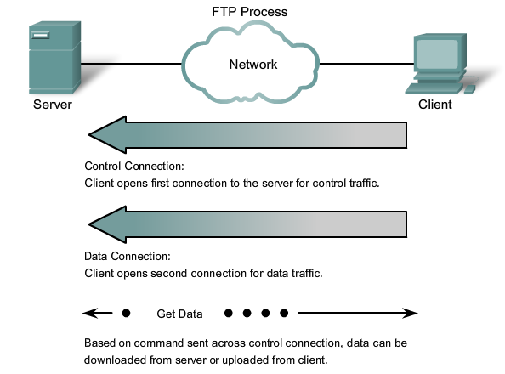
FTP – File Transfer Protocol

Slide 35
FTP
To successfully transfer files, FTP requires two connections between the client and the server: one for commands and replies, the other for the actual file transfer.
The client establishes the first connection to the server on TCP port 21. This connection is used for control traffic, consisting of client commands and server replies.
The client establishes the second connection to the server over TCP port 20. This connection is for the actual file transfer and is created every time there is a file transferred.

Slide 36
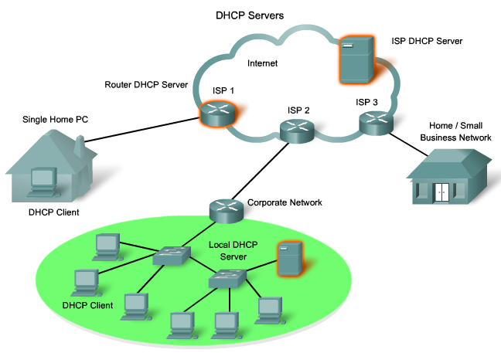
DHCP – Dynamic Host Control Protocol

Slide 37
DHCP Contd...
The Dynamic Host Configuration Protocol (DHCP) service enables devices on a network to obtain IP addresses and other information from a DHCP server.
DHCP allows a host to obtain an IP address dynamically when it connects to the network.
The DHCP server is contacted and an address requested. The DHCP server chooses an address from a configured range of addresses called a pool and assigns ("leases") it to the host for a set period.

Slide 38
DHCP Security
DHCP can pose a security risk because any device connected to the network can receive an address.
This risk makes physical security an important factor when determining whether to use dynamic or manual addressing.
Dynamic and static addressing both have their places in network designs. Many networks use both DHCP and static addressing.
DHCP is used for general purpose hosts such as end user devices, and fixed addresses are used for network devices such as gateways, switches, servers and printers.

Slide 39
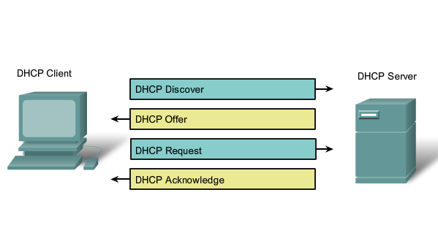
DHCP Message Types

Slide 40
How it Works
When a DHCP-configured device boots up or connects to the network, the client broadcasts a DHCP DISCOVER packet to identify any available DHCP servers on the network.
A DHCP server replies with a DHCP OFFER, which is a lease offer message with an assigned IP address, subnet mask, DNS server, and default gateway information as well as the duration of the lease.
The client may receive multiple DHCP OFFER packets if there is more than one DHCP server on the local network, so it must choose between them, and broadcast a DHCP REQUEST packet that identifies the explicit server and lease offer that the client is accepting.
A client may choose to request an address that it had previously been allocated by the server.

Slide 41
How it Works
Assuming that the IP address requested by the client, or offered by the server, is still valid, the server would return a DHCP ACK message that acknowledges to the client the lease is finalized
If a DHCP NAK message is returned, then the selection process must begin again with a new DHCP DISCOVER message being transmitted.
The DHCP server ensures that all IP addresses are unique (an IP address cannot be assigned to two different network devices simultaneously).

Slide 42
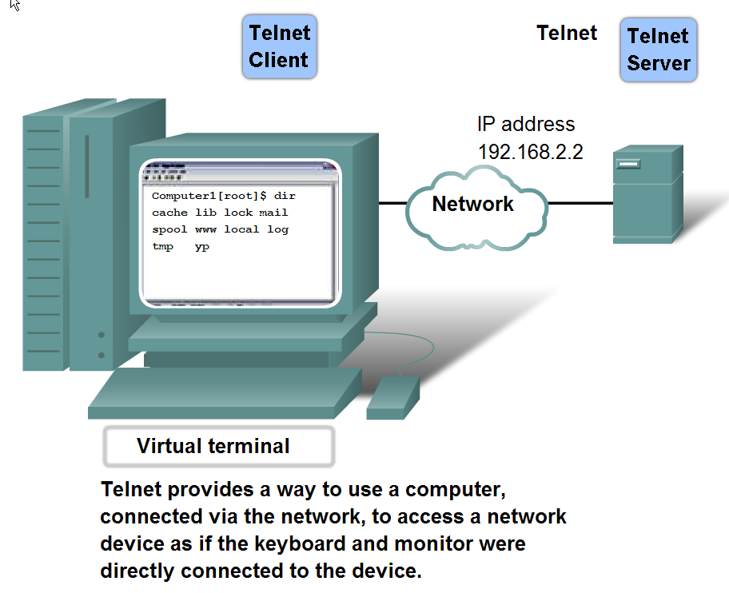
Features, Operation, and Use of TCP/IP Application Layer Services
Describe the features of the Telnet protocol and identify several of its uses in examining and managing networks

Slide 43
Telnet
To support Telnet client connections, the server runs a service called the Telnet daemon.
A virtual terminal connection is established from an end device using a Telnet client application.
Once a Telnet connection is established, users can perform any authorized function on the server, just as if they were using a command line session on the server itself.
If authorized, they can start and stop processes, configure the device, and even shut down the system.

Slide 44
Telnet and Security
While the Telnet protocol supports user authentication, it does not support the transport of encrypted data.
All data exchanged during a Telnet sessions is transported as plain text across the network. This means that the data can be intercepted and easily understood.
If security is a concern, the Secure Shell (SSH) protocol offers an alternate and secure method for server access.
SSH provides the structure for secure remote login and other secure network services.
It also provides stronger authentication than Telnet and supports the transport of session data using encryption. As a best practice, network professionals should always use SSH in place of Telnet, whenever possible.

Slide 45
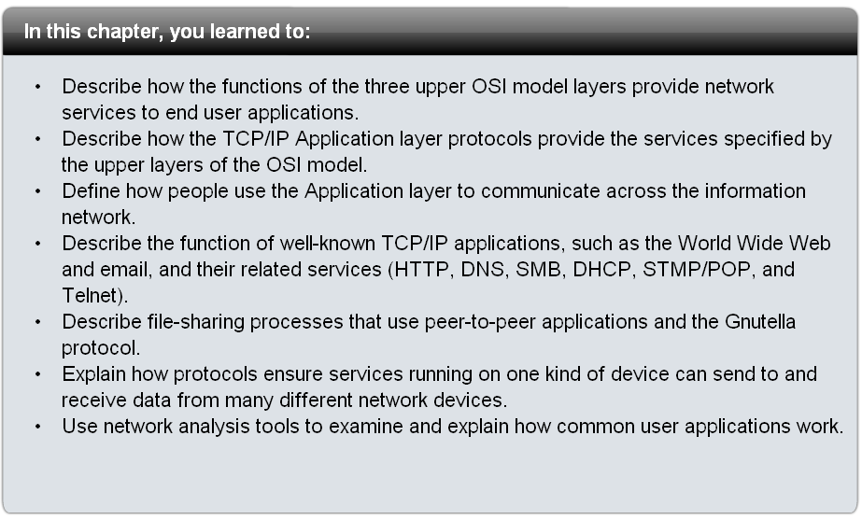
Summary

